Slide 1

BRANCH
Vdd
Vdd_WRITE
CEL
Data0
WL
Data1
BL
…
SL
Datax
Ref
Discharge
Select SL

Slide 2
Local Block
…
LBenable
BL decoder
…
WL0
WL decoder
WL1
…
…
WL2
…
…
WLx-2
WLx-1
WLx
WLref
LBenable
…
BL analog MUX

Slide 3
VDD
BL1
BL2
RH
RL
SL1
SL2
VSS

Slide 4
Global Block
Local Block 0
Local Block 1
S&H
Sense Amplifier

Slide 5








WL decoder

Slide 7
Mtop
Mpassn
Mpassnbar
Mup
Mupbar
Mdown
Mdownbar
Mpassp
Mpasspbar
Mbottom

Slide 8
Vout
VDD
V+
+
Vout
V-
-
V - V
+
-
VSS
Vout
VDD
Voffset
Voffset
V+
-
+
+
Vout
V - V
V-
-
+
-
VSS

Slide 9
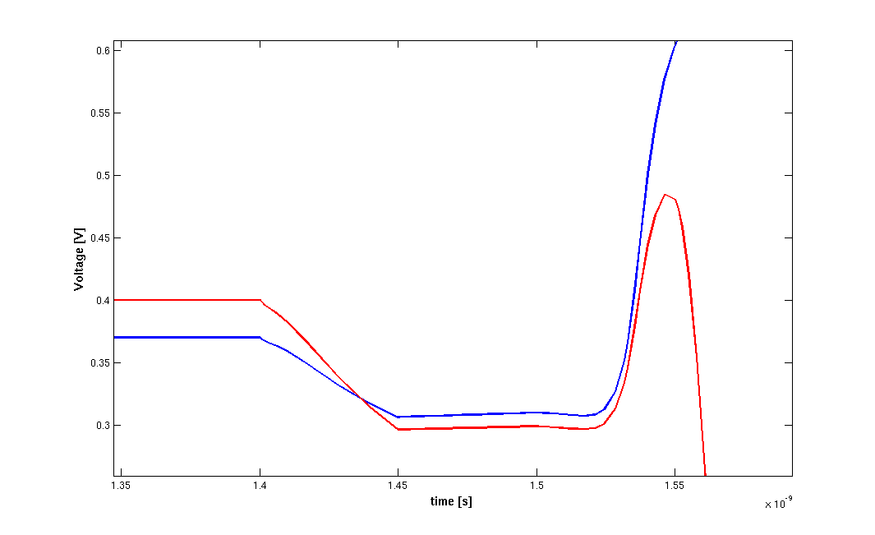
Pass gates turned off
No β variation
latching
nMOS β variation ( )

Slide 10
R
R
CL
Cint
Cint
CL

Slide 11
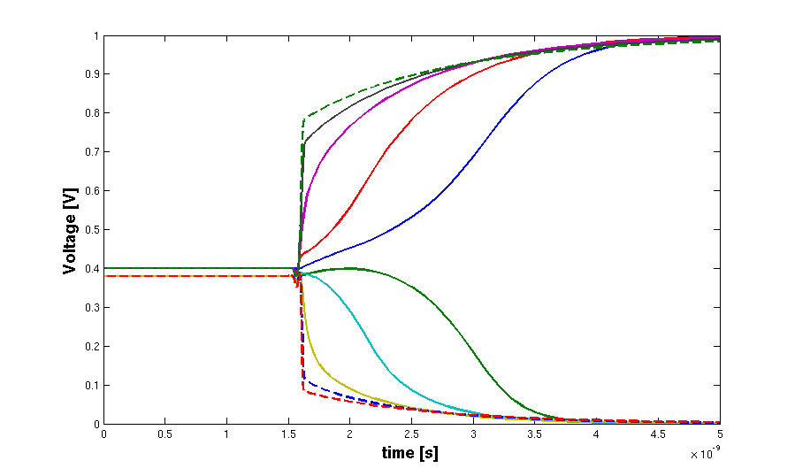
R=0 Ω
R=5 kΩ
R=10 kΩ
R=15 kΩ
R=20 kΩ

Slide 12
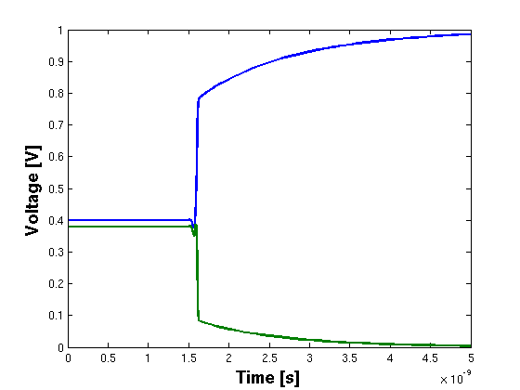
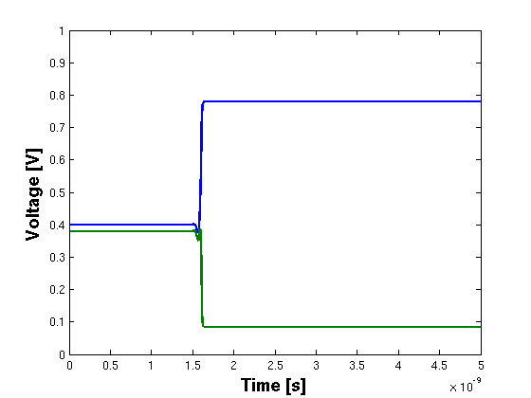
V(t=0)=0.4V
V(t=0)=0.38V
V(t=0)=0.4V
V(t=0)=0.38V
0.4V
+
+
0.38V
-
-

Slide 13
Vcap
V(t) = a t

Slide 14
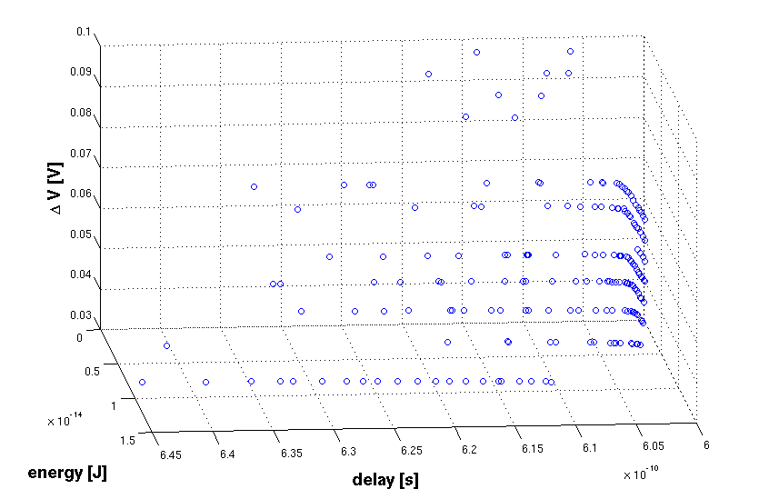

Slide 15
Vx
Vdd
Vs
+
Vdd
Vs
+
-
-
Vx

Slide 16
Vx
Vs
+
Vs
+
-
-
Vx

